Slide 1

Introduction to GitHub

Slide 2
Outline
What is Git & GitHub
GitHub Structure
Important Concepts for GitHub Users
Understanding GitHub Workflow
Setting up GitHub
Upload/Clone Download Repositories

Slide 3
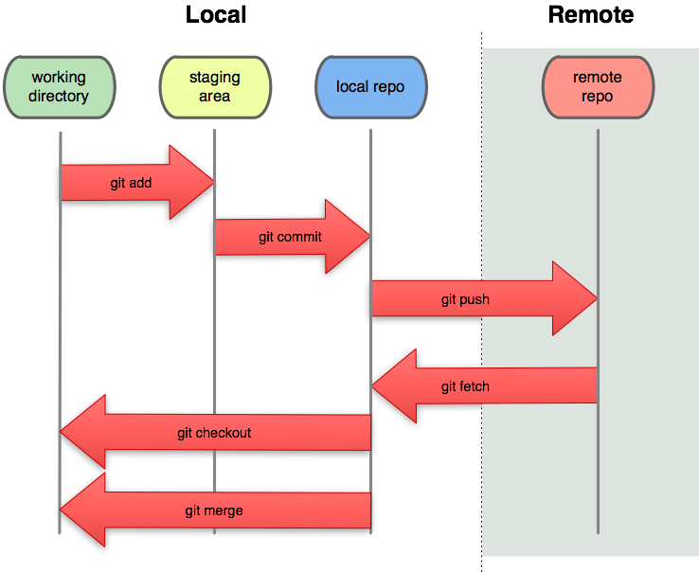

Git & GitHub
git pull

Slide 4
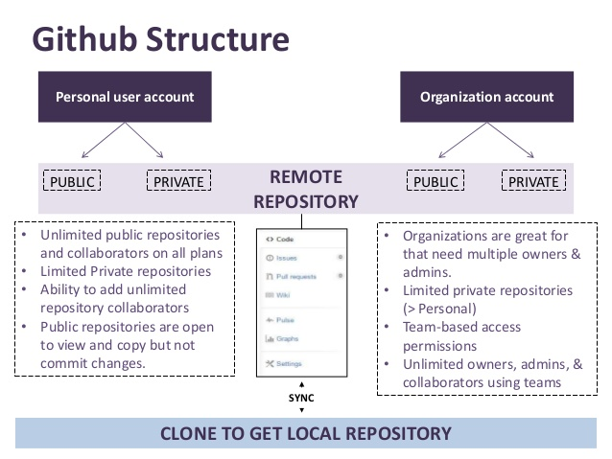
GitHub Structure

Slide 5
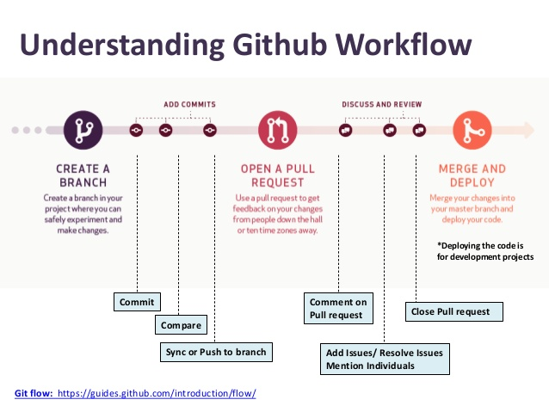
GitHub Workflow

Slide 6
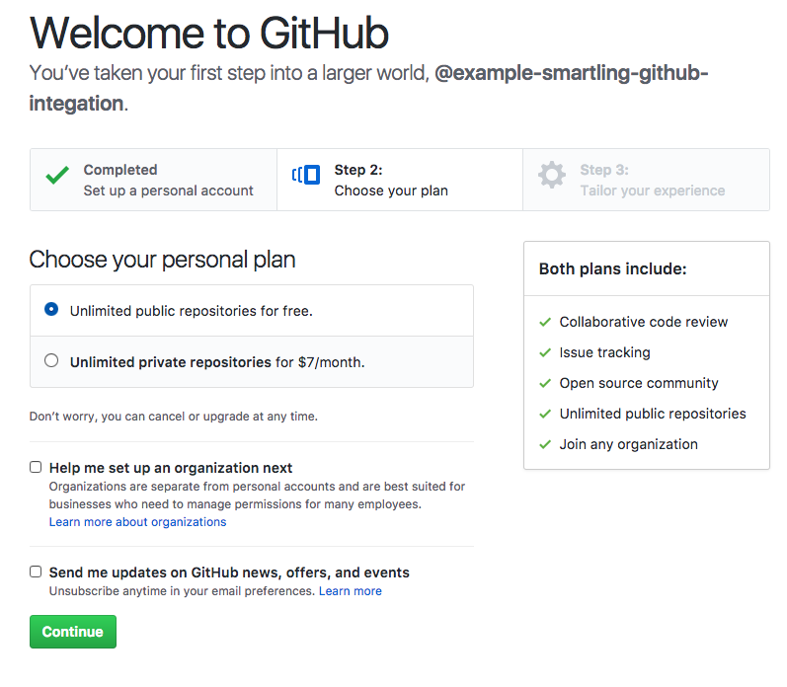
Setting up GitHub

Slide 7
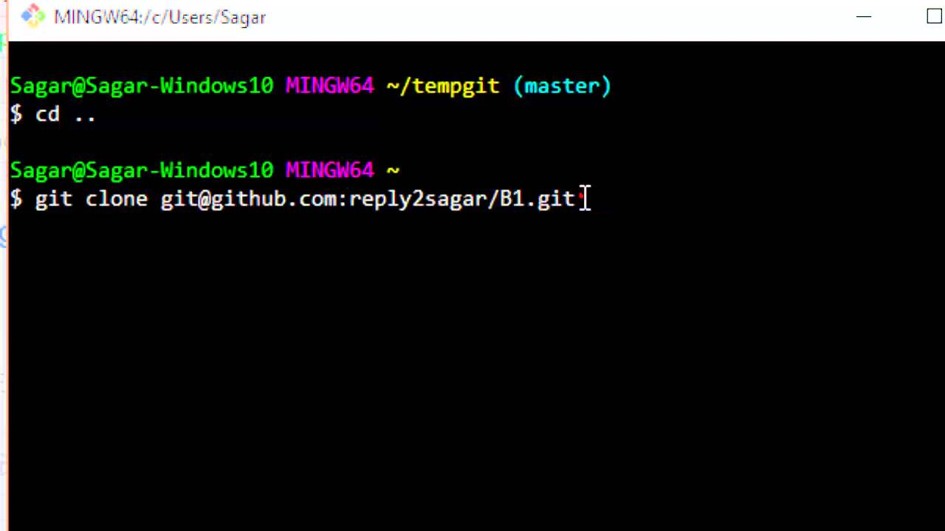
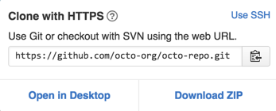
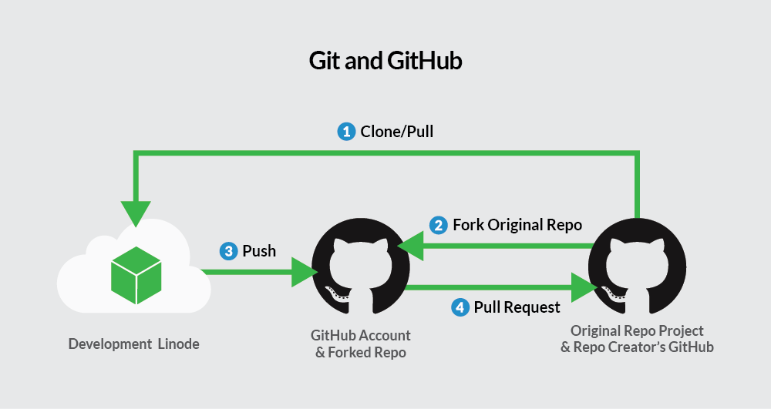
Clone/Upload Repositories

Slide 8
Questions… Thanks for listening..

